Slide 1
Python
Why Learn Python?

Slide 2
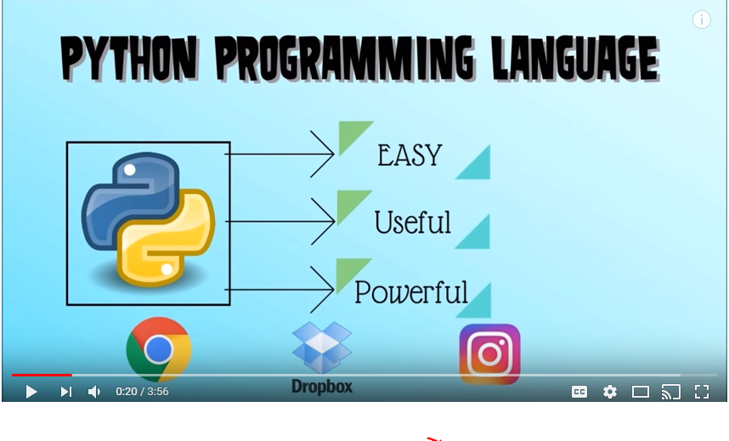
Easy, Useful & Powerful
Reference: https://www.youtube.com/watch?v=hxGB7LU4i1I

Slide 3
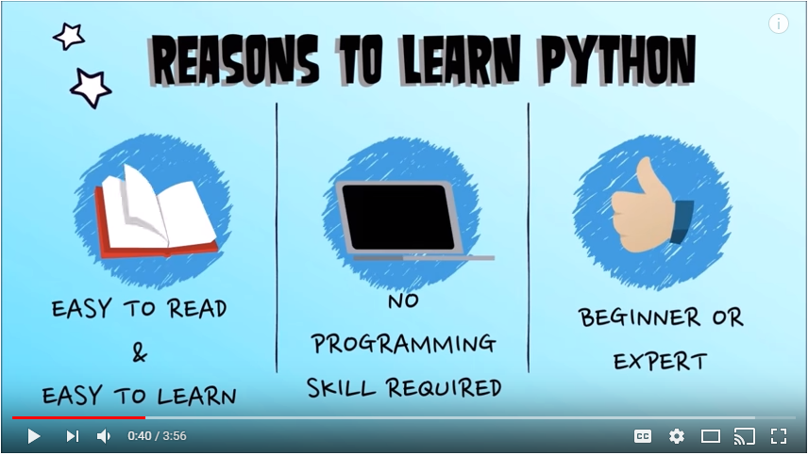
Reasons to Learn Python

Slide 4
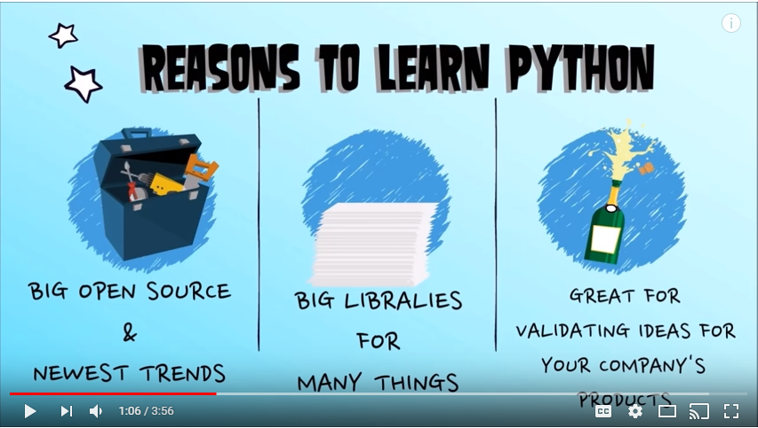
Why Python is still popular?

Slide 5
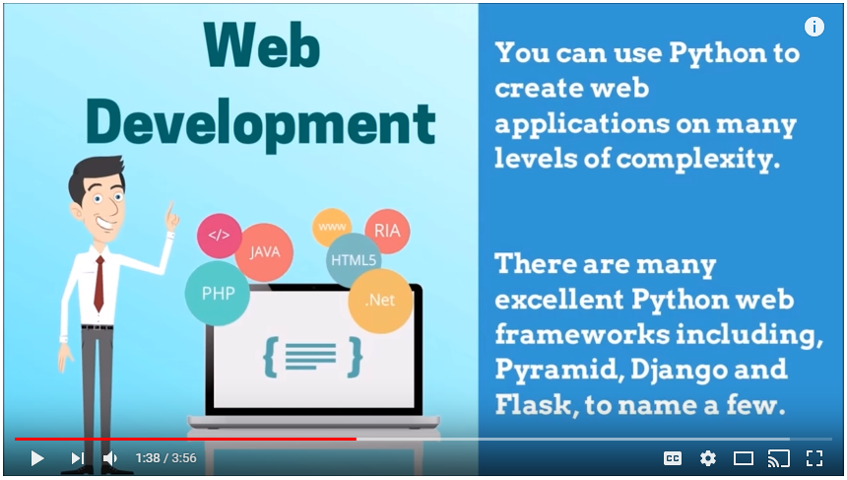
Uses of Python: Web Development

Slide 6
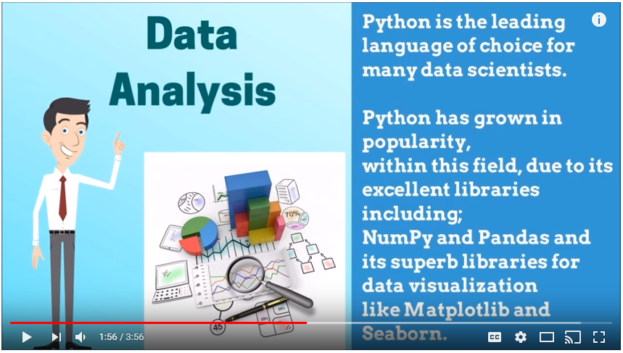
Uses of Python: Data Analysis / Data Science

Slide 7
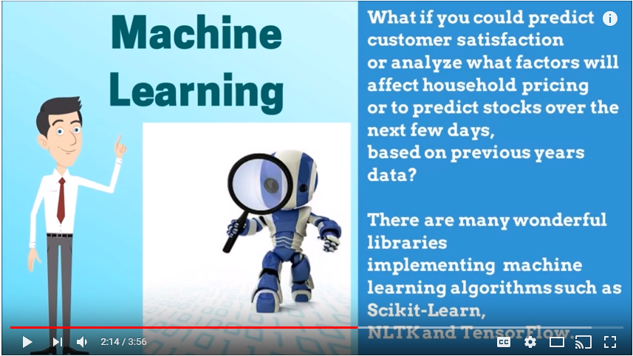
Uses of Python: Machine Learning

Slide 8
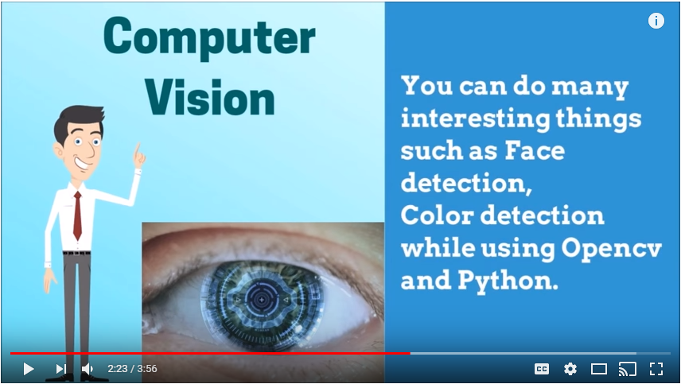
Uses of Python: Computer Vision

Slide 9
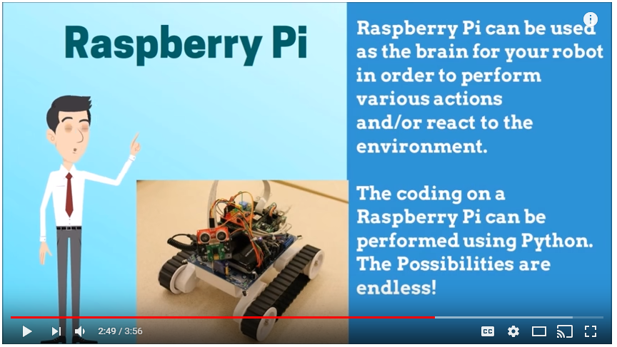
Uses of Python: Robotics/Electronics on Raspberry Pi

Slide 10
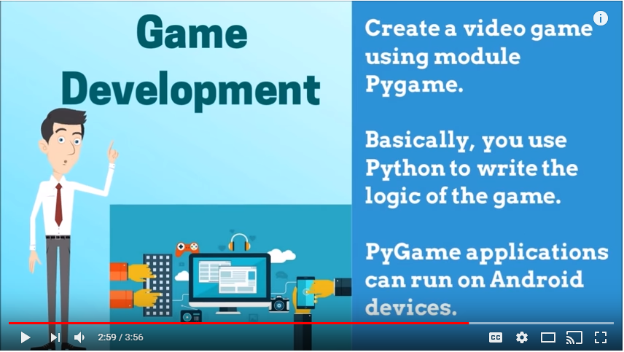
Uses of Python: Game Development

Slide 11
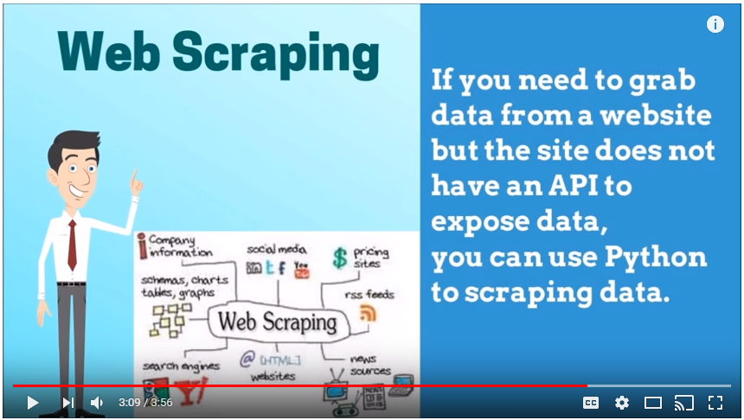
Uses of Python: Web Scraping

Slide 12
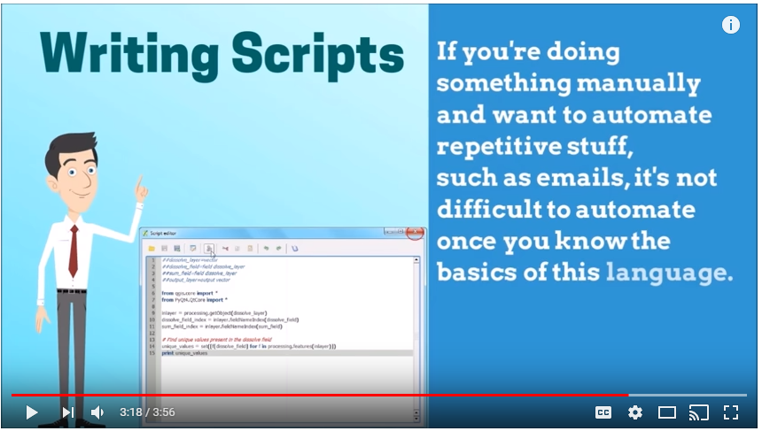
Uses of Python: Writing Scripts

Slide 13
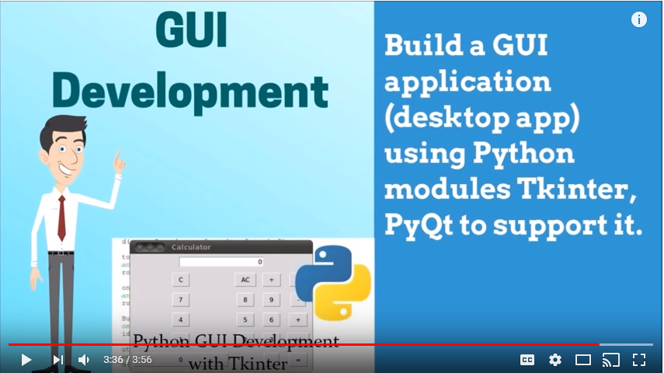
Uses of Python: GUI Development

